Slide 1



Curriculum Maps in Taskstream
Summer 2020 Workshop: Taskstream Series #2
presented by: Mary Elizabeth Spence
July 8, 2020
AState.edu
/ArkansasState
@ArkansasState

Slide 2



Workshop Procedures
Welcome and thank you for participating in our Summer Workshop Series!
You will be muted upon entry to the workshop, so please introduce yourself via the Chat feature by clicking “Chat.”
The window to the right will appear where you can add your introduction:
If you have questions during the session, please add them to the Chat box and at the conclusion of our time we will include them in the Q and A.
AState.edu
/ArkansasState
@ArkansasState

Slide 3
Workshop Agenda
Create and Edit Curriculum Map in Taskstream
Adding Courses/Activities to Maps
Adding Headings to Maps
“Marking” Maps
AState.edu
/ArkansasState
@ArkansasState

Slide 4
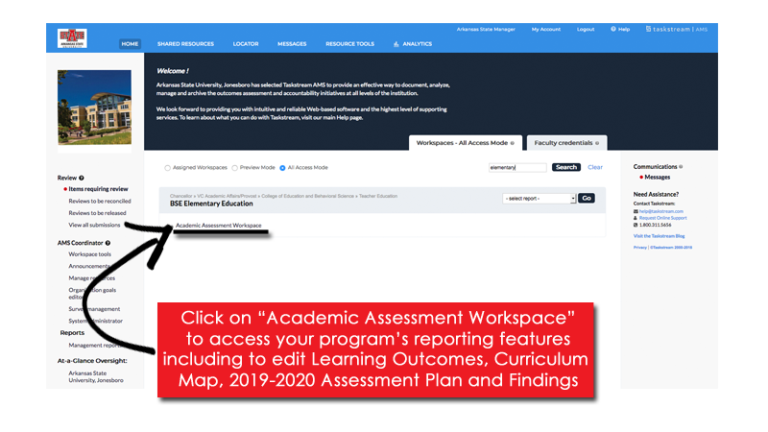

Taskstream Welcome Screen
This screen will show any Programs that you have access to view/edit.
AState.edu
/ArkansasState
@ArkansasState

Slide 5
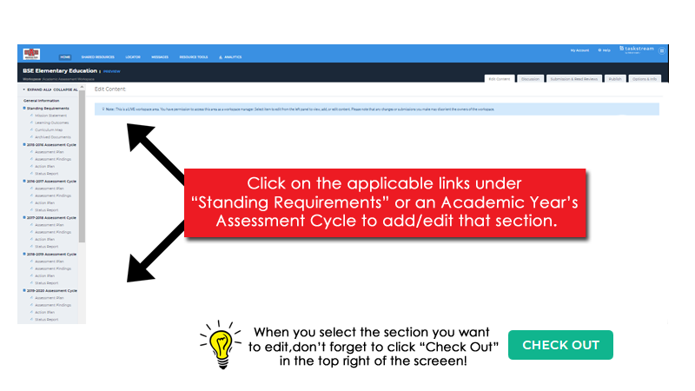
Workspace Landing Screen
This is the initial screen you will see when you select a Workspace.
AState.edu
/ArkansasState
@ArkansasState

Slide 6
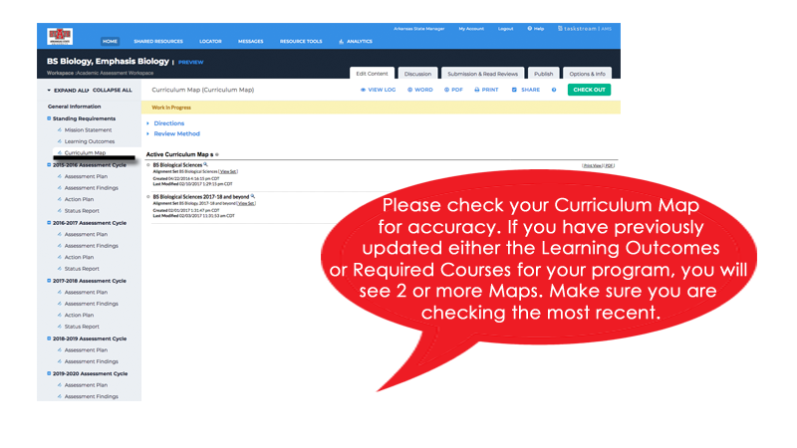
Curriculum Map
Click on “Curriculum Map” on the Left Toolbar
AState.edu
/ArkansasState
@ArkansasState

Slide 7
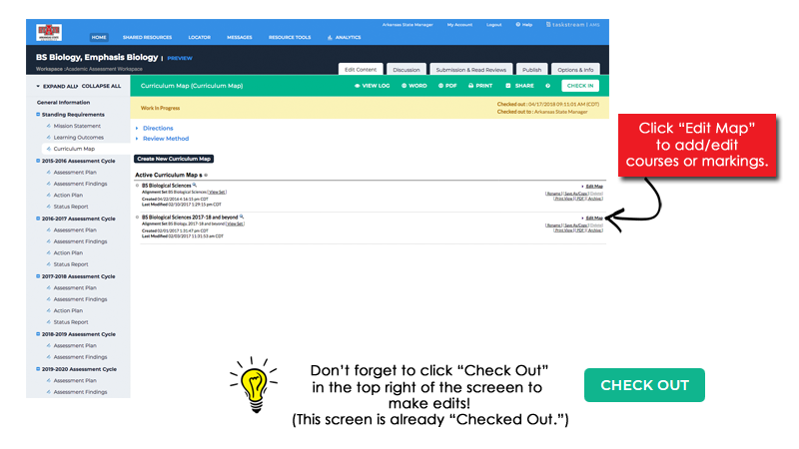
Curriculum Map
AState.edu
/ArkansasState
@ArkansasState

Slide 8
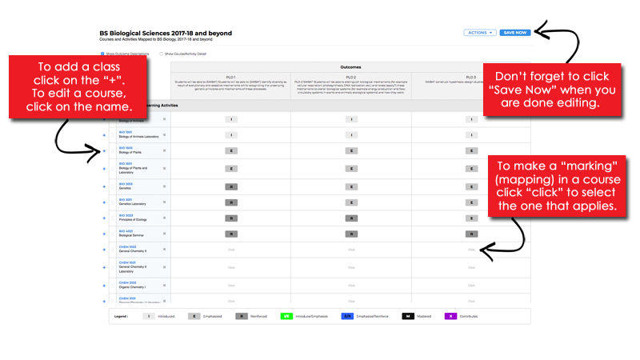
Curriculum Map
After clicking “Edit Map,” the following pop-up will appear.
AState.edu
/ArkansasState
@ArkansasState

Slide 9
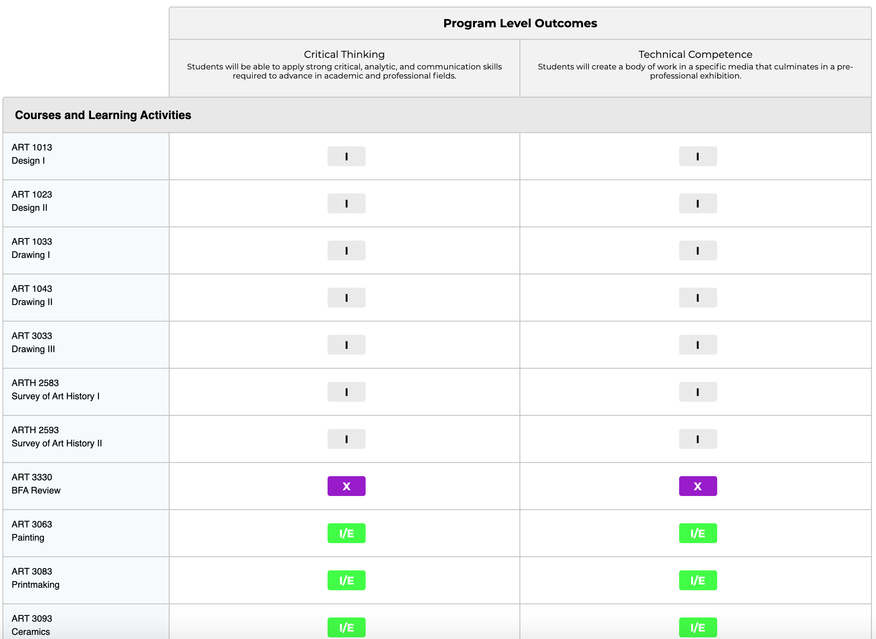
Curriculum Map
Studio Art Example:
AState.edu
/ArkansasState
@ArkansasState

Slide 10
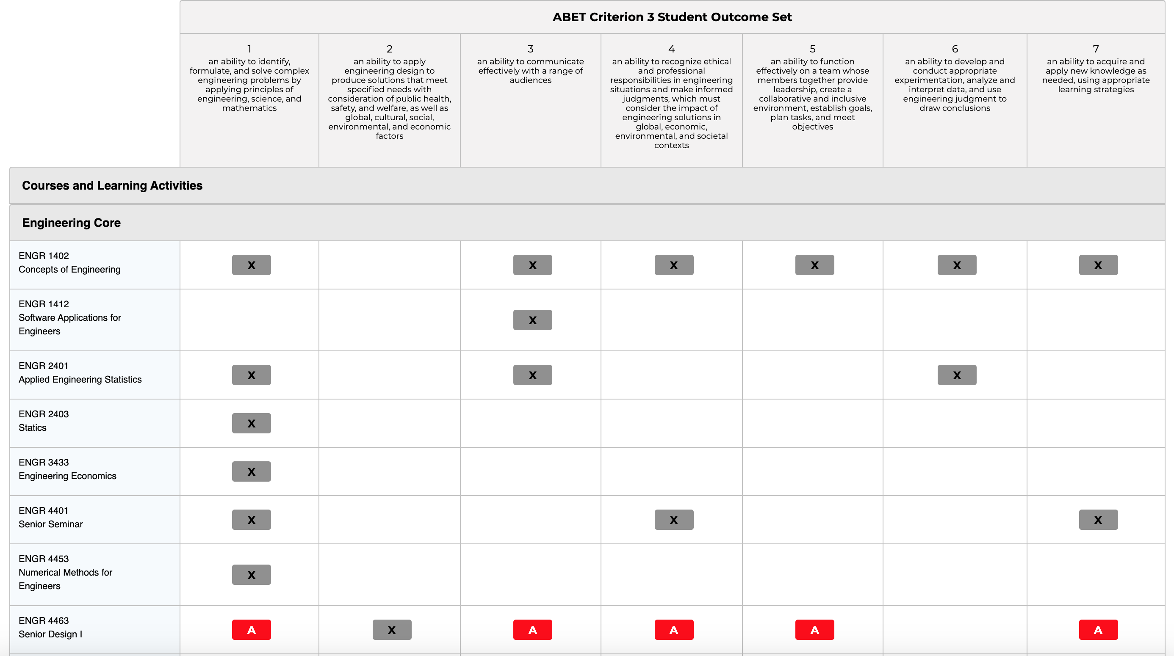
Curriculum Map
Engineering Example:
AState.edu
/ArkansasState
@ArkansasState

Slide 11

Session Q & A
AState.edu
/ArkansasState
@ArkansasState

Slide 12

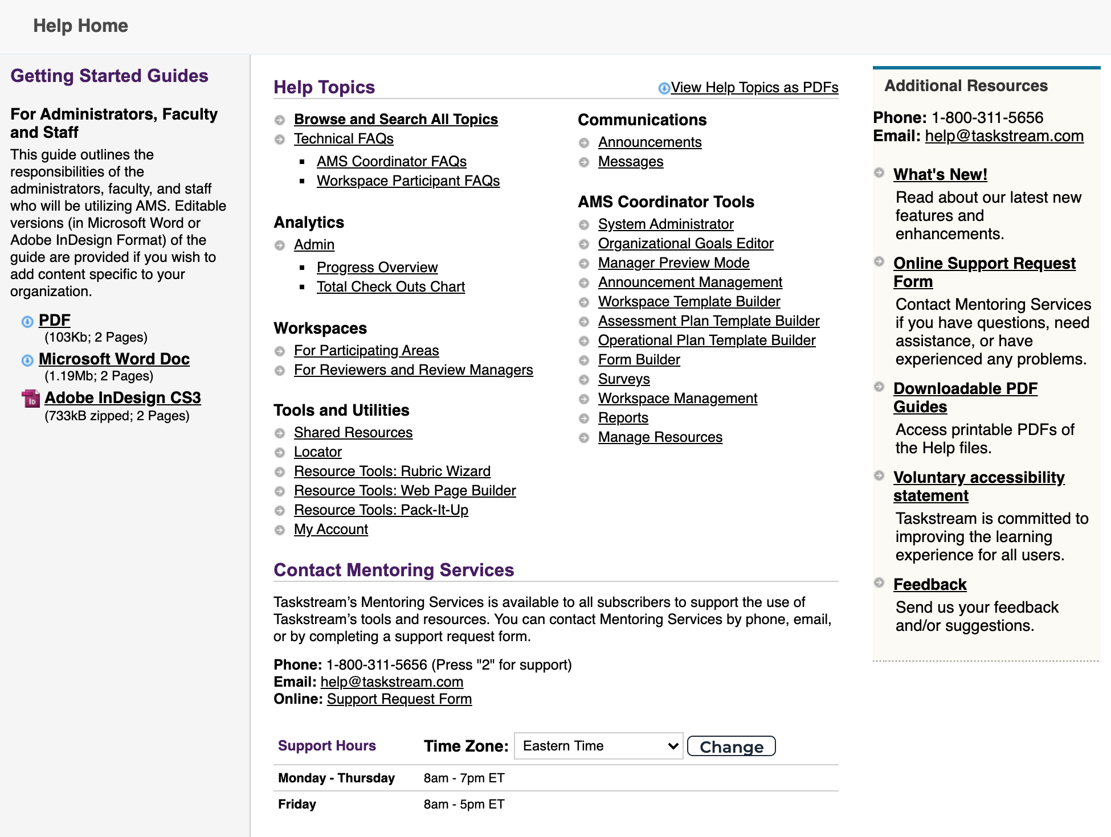
Taskstream Help
For “after hours” assistance, Taskstream has a number of great resources including contact by email and phone and a substantial set of guides. All can be accessed by clicking “? Help”:
AState.edu
/ArkansasState
@ArkansasState

